Slide 1
Normal microbial flora Host-Microbe Interactions
Prepared by
Prof.dr. ihsan edan alsaimary

Slide 2
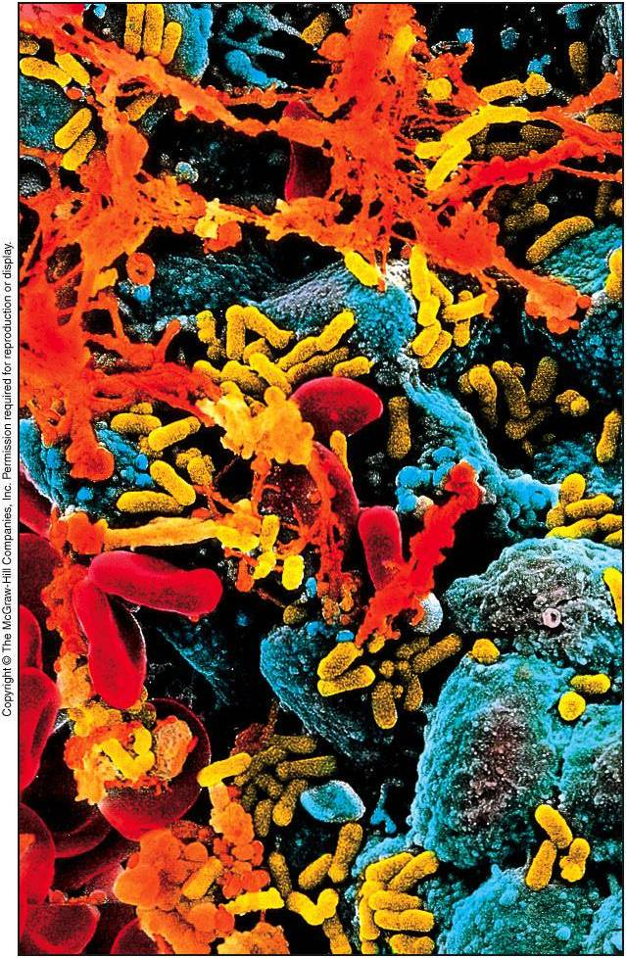

Slide 3
Anatomical Barriers as Ecosystem
Skin and mucous membranes provide anatomical barriers to infection
Also supply foundation for microbial ecosystem
Microbial community offers protection from disease-causing organisms
Intimate interaction between microorganisms and human body is an example of symbiosis

Slide 4
Symbiotic Relationships
Forms of symbiotic relationships
Mutualism
Association in which both partners benefit
Bacteria and synthesis of vitamins K and B
Commensalism
Association in which one partner benefits and other is unharmed
Flora living on skin
Parasitism
Association in which the microbe benefits at expense of host
Pathogenic infection
Symbiotic relationships between microorganism and host
Organisms can have variety of relationships
Symbiotic relationships can be one of several forms
Relationships may change depending on state of host and attributes of microbes

Slide 5
Normal Microbiota (Flora)
Normal Microbiota defined as populations of microorganisms routinely found growing on the body of healthy individual
Resident flora typically inhabit body sites for extended periods
Transient flora are temporary
They form associations for a short time and are replaced

Slide 6
Normal Microbiota
Protection against potentially harmful organisms
Normal flora competitively exclude pathogens through
Covering binding sites used for pathogenic attachment
Consuming available nutrients
Producing toxic compounds such as antibiotics
Development of immune system tolerance
Prevents overreaction to harmless microbes/substances

Slide 7
Normal Microbiota
Dynamic nature of normal Microbiota
Normal flora established during birth process
Once established, composition of flora is dynamic
Changes in response to physiological variation within the host
Each member of flora ecosystem influenced by presence and condition of other members

Slide 8
Symbiotic Relationships
Symbiosis means “to live together”
Describes the relationship between microorganisms and their host
Three types
Mutualism
Commenalism
Parasitism

Slide 9
The Three Types of Symbiotic Relationships
Table 14.1

Slide 10
Normal Microbiota
Also termed normal flora and indigenous microbiota
Refers to the organisms that colonize the body’s surfaces without normally causing disease
Two types
Resident microbiota
Transient microbiota

Slide 11
Resident Microbiota
Are a part of the normal microbiota throughout life
Most are commensal

Slide 12
Resident Microbiota
Table 14.2.1

Slide 13
Resident Microbiota
Table 14.2.2

Slide 14
Transient Microbiota
Remain in the body for only hours to months before disappearing
Found in the same regions as resident microbiota
Cannot persist in the body
Competition from other microorganisms
Elimination by the body’s defenses cells
Chemical or physical changes in the body

Slide 15
Acquisition of Normal Microbiota
Development in the womb(uterus) is generally free of microorganisms
Microbiota begins to develop during the birthing process
Much of ones resident microbiota established during the first months of life

Slide 16
Opportunistic Pathogens
Normal microbiota or other normally harmless microbes that can cause disease under certain circumstances
Conditions that provide opportunities for pathogens
Immune suppression
Changes in the normal microbiota – changes in relative abundance of normal microbiota may allow opportunity for a member to thrive and cause disease
Introduction of normal microbiota into unusual site in the body

Slide 17
Contamination vs. Infection
Contamination – the mere presence of microbes in or on the body
Infection – results when the organism has evaded the body’s external defenses, multiplied, and become established in the body

Slide 18
Portals of Entry
Sites through which pathogens enter the body
Four major types
Skin
Mucous membranes
Placenta
Parenteral route

Slide 19
Skin
Outer layer of packed, dead, skin cells usually acts as a barrier to pathogens
Some pathogens can enter through openings or cuts
Others enter by burrowing into or digesting the outer layers of skin

Slide 20
Mucous Membranes
Line the body cavities that are open to the environment
Provides a moist, warm environment that is hospitable to pathogens
Respiratory tract is the most commonly used site of entry – entry is through the nose, mouth or eyes
Pathogens able to survive the acidic pH of the stomach may use the gastrointestinal tract as a route of entry

Slide 21
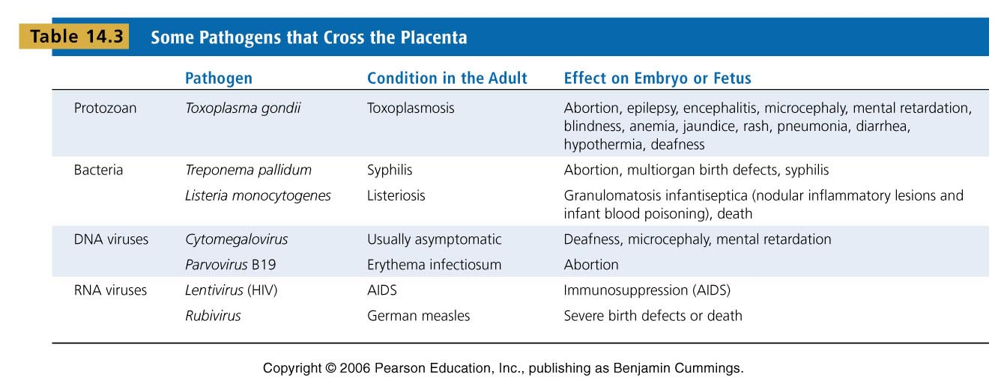
Some Pathogens that Cross the Placenta
Table 14.3

Slide 22
Parenteral Route
Not a true portal of entry but a means by which the usual portals can be circumvented
Pathogens deposited directly into tissues beneath the skin or mucous membranes

Slide 23
Infection vs. Disease
Infection is the invasion of the host by a pathogen
Disease results only if the invading pathogen alters the normal functions of the body
Disease is also referred to as morbidity

Slide 24
Manifestations of Disease
Symptoms – subjective characteristics of disease felt only by the patient
Signs – objective manifestations of disease that can be observed or measured by others
Syndrome – group of symptoms and signs that characterize a disease or abnormal condition
Asymptomatic, or subclinical, infections lack symptoms but may still have signs of infection

Slide 25
Etiology
Study of the cause of disease
Germ theory of disease – disease caused by infections of pathogenic microorganisms
Robert Koch developed a set of postulates one must satisfy to prove a particular pathogen causes a particular disease

Slide 26
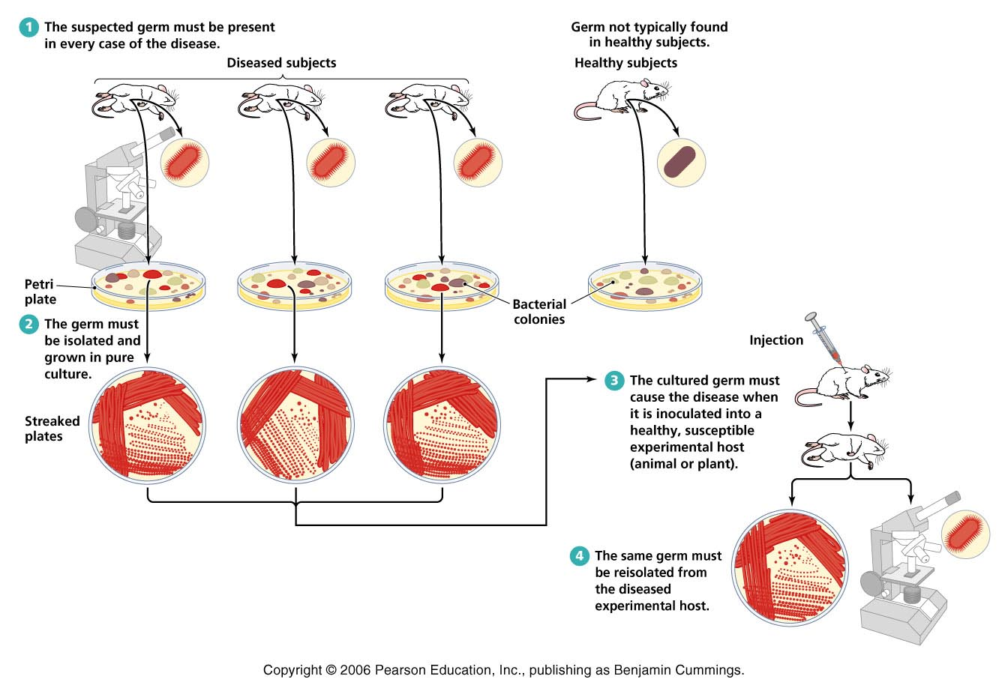
Koch’s Postulates
Figure 14.7

Slide 27
Exceptions to Koch’s Postulates
Using Koch’s postulates is not feasible in all cases
Some pathogens can’t be cultured in the laboratory
Some diseases are caused by a combination of pathogens and other cofactors
Ethical considerations prevent applying Koch’s postulates to pathogens that require a human host

Slide 28
Virulence Factors of Infectious Disease
Pathogenicity – ability of a microorganism to cause disease
Virulence – degree of pathogenicity
Virulence factors contribute to an organisms virulence
Adhesion factors
Biofilms
Extracellular enzymes
Toxins
Antiphagocytic factors

Slide 29
Extracellular Enzymes
Enzymes secreted by the pathogen
Dissolve structural chemicals in the body
Help pathogen maintain infection, invade further, and avoid body defenses

Slide 30
Toxins
Chemicals that harm tissues or trigger host immune responses that cause damage
Toxemia refers to toxins in the bloodstream that are carried beyond the site of infection
Two types
Exotoxins
Endotoxins

Slide 31
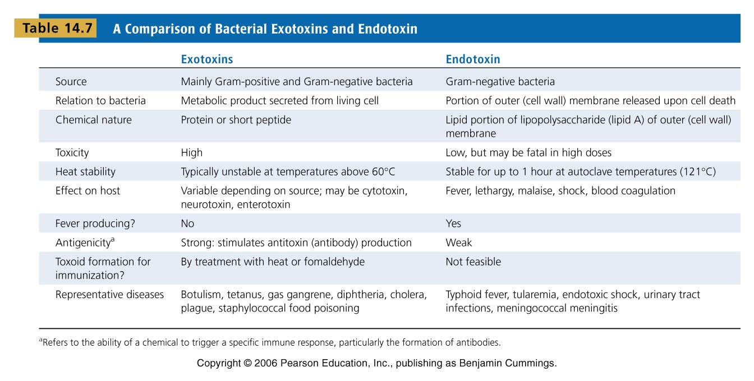
A Comparison of Bacterial Exotoxins and Endotoxins
Table 14.7

Slide 32
Antiphagocytic Factors
Certain factors prevent phagocytosis by the host’s phagocytic cells
Bacterial capsule
Often composed of chemicals found in the body and not recognized as foreign
Can be slippery making it difficult for phagocytes to engulf the bacteria
Antiphagocytic chemicals
Some prevent fusion of lysosome and phagocytic vesicles
Leukocidins directly destroy phagocytic white blood cells

Slide 33
The Stages of Infectious Disease
Following infection, sequence of events called the disease process occurs
Many infectious diseases have five stages following infection
Incubation period
Prodromal period
Illness
Decline
Convalescence

Slide 34
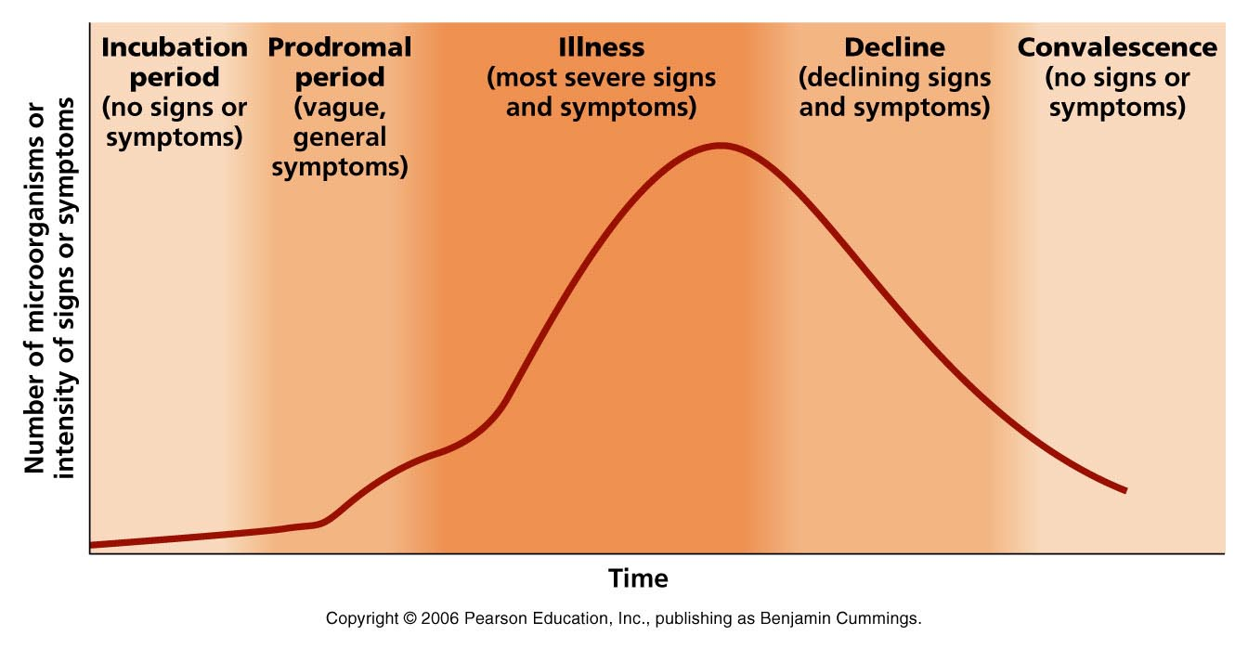
The Stages of Infectious Disease
Figure 14.10

Slide 35
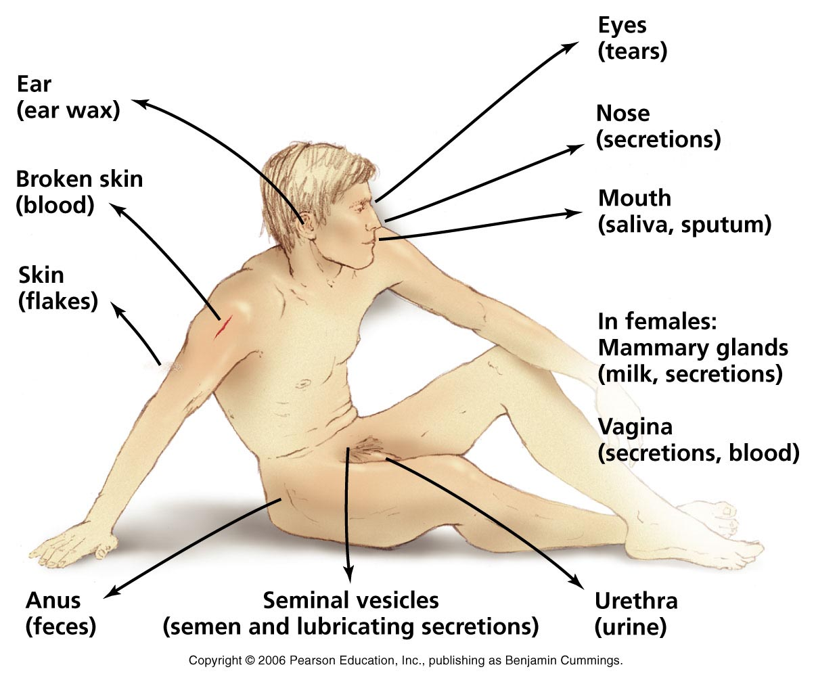
Movement of Pathogen Out of Host
Pathogens leave host through portals of exit

Slide 36
Reservoirs of Infection
Most pathogens cannot survive long outside of their host
Sites where pathogens are maintained as a source of infection are termed reservoirs of infection
Three types of reservoirs
Animal reservoir
Human carriers
Nonliving reservoir

Slide 37
Animal Reservoirs
Zoonoses – diseases that are naturally spread from their usual animal host to humans
Acquire zoonoses through various routes
Direct contact with animal or its waste
Eating animals
Bloodsucking arthropods
Humans are usually dead end host to zoonotic pathogens

Slide 38
Human Carriers
Carriers: Infected individuals who are asymptomatic but infective to others
Some individuals will eventually develop illness while others never get sick
Healthy carriers may have defensive systems that protect them from illness

Slide 39
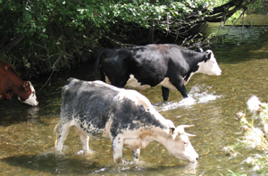
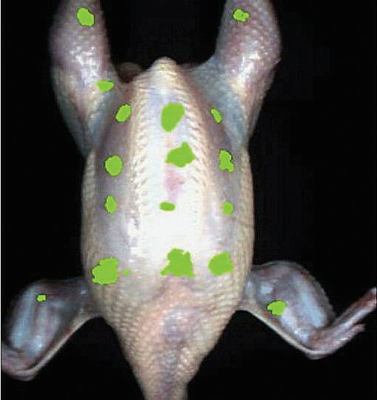
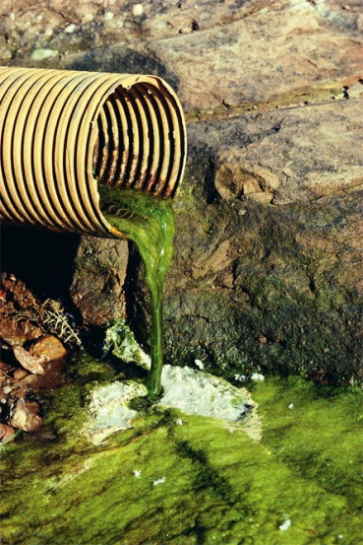
Nonliving Reservoirs
Soil, water, and food can be reservoirs of infection
Presence of microorganisms is often due to contamination by feces or urine
Spectral scan of chicken carcass showing areas of fecal contaminants
(nasaimages.org)

Slide 40
Modes of Infectious Disease Transmission
Transmission from either a reservoir or portal of exit
Three groups
Contact transmission
Vehicle transmission
Vector transmission

Slide 41
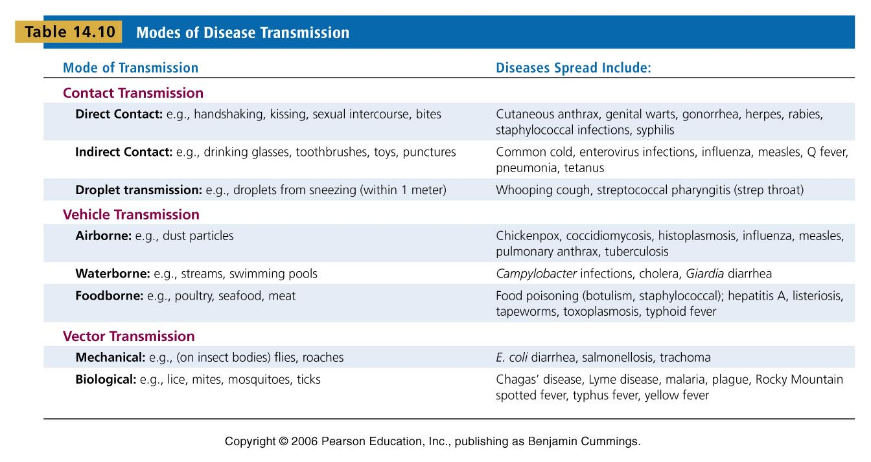
Modes of Disease Transmission
Table 14.10

Slide 42
Classification of Infectious Diseases
Many different methods of classification
The body system they affect
The taxonomic groups of the causative agent
Their longevity and severity
How they are spread to their host

Slide 43
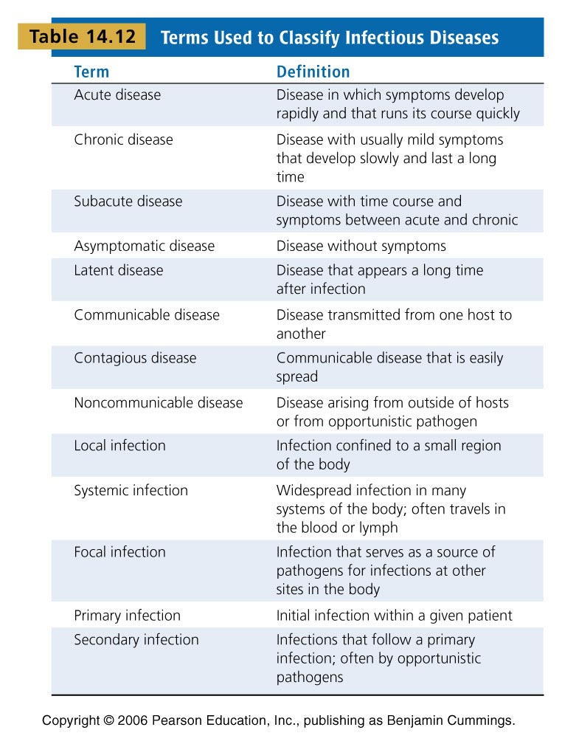
Terms Used to Classify Infectious Diseases
Table 14.12

Slide 44
Principles of Infectious Disease
If colonized organisms have parasitic relationship with host, the term infection applies
Infection does not always lead to noticeable adverse effects
Termed subclinical or inapparent
Symptoms do not appear or are mild enough to go unnoticed
Infection that results in disease is termed infectious disease
Disease causes characteristic signs and symptoms
Symptoms are effects experienced by patient such as pain and nausea
Signs are effects that can be observed through examination
Rash, puss formation and swelling

Slide 45
Principles of Infectious Disease
One infectious disease may leave individual predisposed to developing new disease
Initial disease is termed primary infection
Additional infections resulting from primary infection are termed secondary infection

Slide 46
Pathogenicity
Pathogens are organisms that can cause disease in otherwise healthy people
That pathogen termed primary pathogen
Microbes that cause disease when the body’s defenses are down termed opportunistic pathogen
Virulence is quantitative term referring to pathogen’s disease-causing ability
Highly virulent organisms have high degree of pathogenicity
These organisms more likely to cause disease
Example: Streptococcus pyogenes
Causes disease from strep throat to necrotizing fasciitis

Slide 47
Characteristics of infectious disease
Disease that spreads from host to host termed communicable or contagious
Ease of spread partly determined by infectious dose
Infectious dose is number of organisms required to establish infection
Diseases with small infectious dose more easily spread than those requiring large numbers

Slide 48
Course of infectious disease
Disease course follows several stages
Incubation
Time between introduction of organism to onset of symptoms
Incubation period depends on numerous factors
Illness
Follows incubation
Individual experiences signs and symptoms of disease
Convalescence
Period of recuperation and recovery
Infectious agents may still be spread

Slide 49
Duration of Symptoms
Acute
Symptoms have rapid onset and last only short time
Chronic
Symptoms develop slowly and persist
Latent
Infection never completely eliminated
Infection becomes reactive

Slide 50
Distribution of pathogen
Infections often described according to distribution within the body
Localized
Infection limited to small area
Example = boil
Systemic or generalized
Agent has spread or disseminated throughout the body
Example = measles
Toxemia
Toxins circulating in blood
Viremia
Viruses circulating in blood
Septicemia
Acute life-threatening illness causes by infectious agent or its products circulating in blood

Slide 51
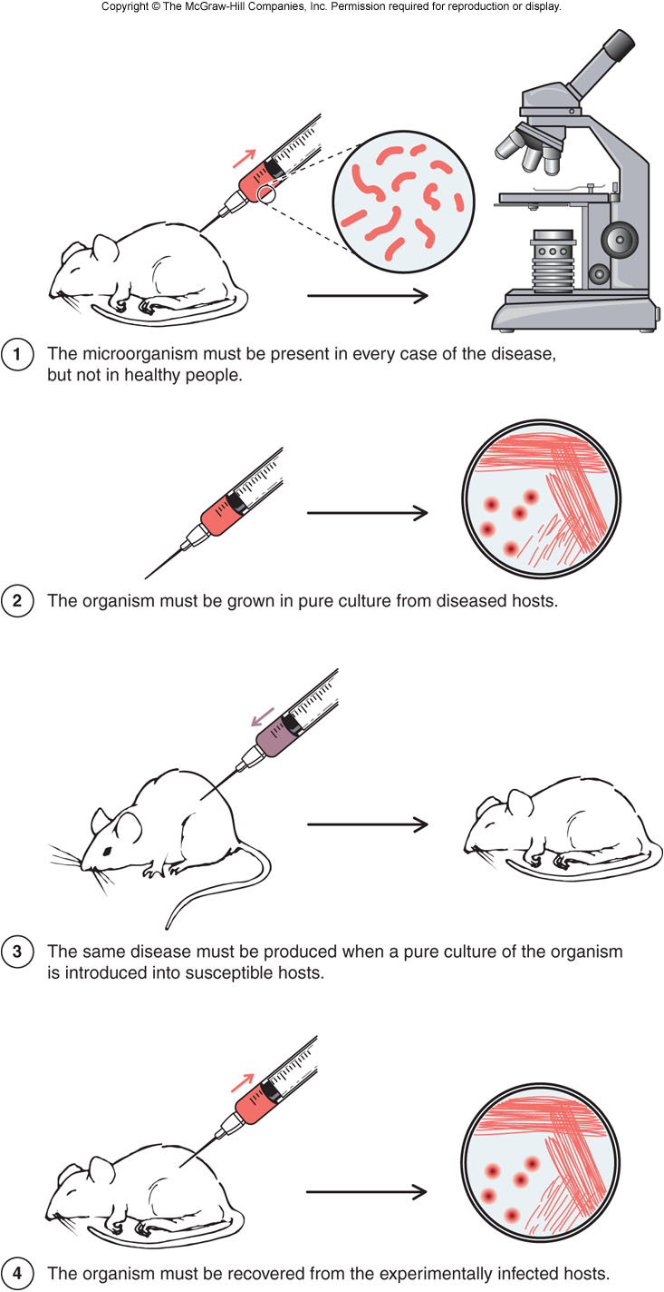
Establishing Cause of Infectious Disease
Koch’s Postulates
Robert Koch proposed postulates to conclude that a particular organism causes a specific disease
Causative relationship established if these postulates fulfilled:
The microbe must be present in every case of disease
Must be pure culture from diseased host
Same disease must be produced in susceptible experimental host
Must be recovered from experimental host

Slide 52
Establishing Cause of Infectious Disease
Molecular Koch’s Postulates
Virulence factor—gene or products should be found in pathogenic strain
Mutating the virulence gene to disrupt function should reduce virulence of the pathogen
Reversion of mutated virulence gene or replacement with wild type version should restore virulence to strain

Slide 53
Establishing Cause of Infectious Disease
Mechanisms of pathogenesis
Human body is a source of nutrient as long as the innate and adaptive immunity can be overcome
Ability to overcome obstacles of immunity separates pathogens from non-disease causing organisms
Mechanism used to overcome immune response termed mechanisms of pathogenicity
Arsenal of mechanisms referred to as virulence determinants

Slide 54
Establishing Cause of Infectious Disease
Mechanisms of pathogenesis
Immune responses do not need to be overcome indefinitely
Only long enough for organisms to multiply and leave host
Pathogens and host evolve over time to state of balanced pathogenicity
Pathogen becomes less virulent while host becomes less susceptible

Slide 55
Mechanisms of pathogenesis
Mechanisms of disease follow several patterns
Production of toxins that are ingested
Foodborne intoxication
Clostridium botulinum and Staphylococcus aureus
Colonization of mucous membranes followed by toxin production
Organism multiplies to high numbers on host surface then produces toxin that interferes with cell function
E. coli O157:H7 and Vibrio cholerae
Invasion of host tissue
Microbes penetrate barriers and multiply in tissues
Generally have mechanism to avoid destruction by macrophages
Mycobacterium tuberculosis and Yersinia pestis
Invasion of host tissues followed by toxin production
Penetration of host barriers with addition of toxin production
Streptococcus pyogenes

Slide 56
Establishment of Infection
In order to cause disease, pathogen must follow a series of steps
Adherence
Colonization
Delivery of effector molecules
Adherence
Pathogen must adhere to host cells to establish infection
Bacteria use adhesins
Often located at the top of pili or fimbriae
Binding of adhesins to host cell receptors is highly specific
Often dictates type of cell to which bacteria can attach

Slide 57
Establishment of Infection
Colonization
Organism must multiply in order to colonize
New organisms must compete with established organisms for nutrients and space
New organism must also overcome toxic products produced by existing organisms as well as host immune responses
Microbes have developed counterstrategies, including rapid turnover of pili
Some organisms produce iron-binding molecules called siderophores
Compete with host proteins for circulating iron

Slide 58
Establishment of Infection
Delivery of effector molecules to host cells
After colonization some bacteria are able to deliver molecules directly to host
Induce changes to recipient cell that include
Loss of microvilli
Directed uptake of bacterial cells
Type III secretion system

Slide 59
Invasion – Breaching Anatomical Barriers
Penetration of skin
Skin is most difficult barrier to penetrate
Bacteria that penetrate via this route rely on trauma that destroys skin integrity
Penetration of mucous membranes
Most common route of entry
Two general mechanisms
Directed uptake
Exploitation of antigen sampling

Slide 60
Invasion – Breaching Anatomical Barriers
Penetration of mucous membranes
Directed uptake of cells
Some pathogens induce non-phagocytic cells into endocytosis
Causes uptake of bacterial cells
Bacteria attaches to cell then triggers uptake
Disruption of cytoskeleton due to endocytosis may cause changes in cell membrane
Termed ruffling

Slide 61
Invasion – Breaching Anatomical Barriers
Penetration of mucous membranes
Exploitation of antigen sampling
Occurs often in intestinal tissues
Between M cells and Peyer’s patches
M cells conduit between intestinal lumen and lymphoid tissue
Microbes move to tissues through transcytosis
Most organisms are destroyed by macrophages
Some organisms have developed mechanisms to survive phagocytosis
Bacteria escape cells by inducing apoptosis

Slide 62
Avoiding Host Defenses
Hiding within the host
Some organisms evade host defenses by remaining within host
Out of reach of phagocytosis
Once inside certain bacteria orchestrate transfer from cell to cell
Actin tails
Propels bacteria within cell
Can propel with such force that it drives microbe through membrane into neighboring cell

Slide 63
Avoiding Host Defenses
Avoiding being killed by complement proteins
Gram-negative cells susceptible to MAC attack
MAC has little effect on gram-positive cells
Certain bacteria can circumvent killing by complement (MAC)
Termed serum resistant
Bacterial cells hijack protective mechanism used by host cells
Inhibits formation of MAC

Slide 64
Avoiding Host Defenses
Avoiding destruction by phagocytosis
Preventing encounters with phagocytes
Some pathogens prevent phagocytosis by avoiding phagocytic cells
Some cells destroy complement components that attract phagocytes through
C5a peptidase – degrades component C5a
Producing membrane-damaging toxins – kills phagocytes by forming pores in membrane

Slide 65
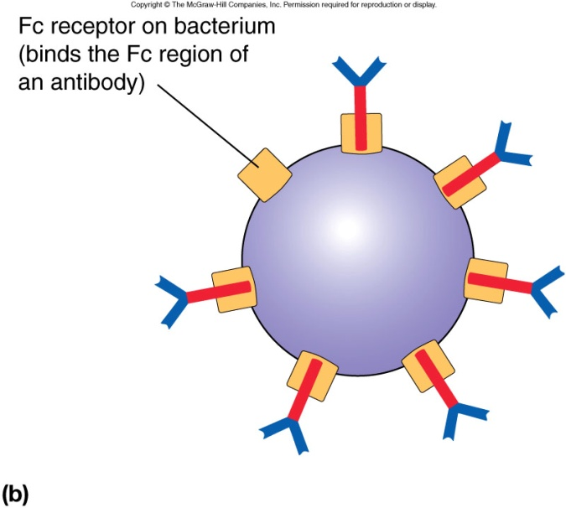
Avoiding Host Defenses
Avoiding destruction by phagocytosis
Mechanisms include
Capsule
Interfere with alternative pathway of complement activation
Bind host regulatory protein to inactivate C3b
M protein
Binds complement regulatory protein
Inactivates C3b
Fc receptors
Foil opsonization
Bind Fc region of antibodies interferes with binding to bacteria

Slide 66
Avoiding Host Defenses
Surviving within the phagocyte
Allows bacteria to hide from antibodies and control immune response
Mechanisms include
Escape from phagosome
Escapes before phagosome-lysosome fusion
Allows bacteria to multiply in cytoplasm
Preventing phagosome-lysosome fusion
Avoids exposure to degradative enzymes of lysosome
Surviving within phagolysosome
Delay fusion to allow organism time to equip itself for growth within phagosome

Slide 67
Avoiding Host Defenses
Avoiding antibodies
Mechanisms
IgA protease
Cleaves IgA antibodies
Antigenic variation
Alteration of surface antigens
Allows bacteria to stay ahead of antibody production
Mimicking host molecules
Pathogens can cover themselves with molecules that resemble normal host “self” molecules

Slide 68
Damage to the Host
In order to cause disease, pathogen must cause damage
Damage facilitates dispersal of organisms
Vibrio cholerae causes diarrhea
Bordetella pertussis causes coughing
Damage can be direct result of pathogen, such as toxin production, or indirect via immune response

Slide 69
Damage to the Host
Exotoxins
Numerous organisms produce exotoxins
Have very specific damaging effects
Among most potent toxins known
Often major cause of damage to infected host
Exotoxins are secreted by bacterium or leak into surrounding fluids following cell lysis
Toxins act locally or systemically
Made of protein
Makes them heat labile
So powerful fatal damage can occur before adequate immune response mounted
Passive immunity in form of antitoxin can be given as treatment

Slide 70
Damage to the Host
Exotoxins
Can be grouped into functional categories
Neurotoxins
Cause damage to nervous system
Major symptom is paralysis
Enterotoxins
Damage to intestines and tissues of digestive tract
Major symptom is vomiting and diarrhea
Cytotoxins
Damage to variety of cells
Damage caused by interference with cell function or cell lysis

Slide 71
Damage to the Host
A-B toxins
Toxins consist of two parts
A subunit
Toxic or active part
B subunit
Binding part
Binds to specific host cell receptors
Structure offers novel approaches to development of vaccine and other therapies
Use toxin structure as binding a delivery system

Slide 72
Damage to the Host
Membrane-damaging toxins
Disrupt plasma membrane
Cause cell lysis
Some membrane-damaging toxins produce pores that allow fluids to enter causing cell destruction
Phospholipases are group of potent membrane-damaging toxins
Remove polar heads of phospholipid
Destabilizes membrane

Slide 73
Damage to the Host
Superantigens
Override specificity of T cell response
Causes toxic effects due to massive release of cytokines by large number of helper T cells
Superantigens short-circuit normal control mechanisms of antigen process and presentation
Binds MHC class II and T cell receptor
Causes activation of 1 in 5 T cells

Slide 74
Damage to the Host
Endotoxins
Endotoxins are LPS of gram-negative cell wall
Toxin fundamental part of gram-negative organism
Endotoxins are heat stable
Lipid A responsible for toxic properties
Symptoms associated with vigorous immune response
Toxin responsible for septic shock
a.k.a endotoxic shock

Slide 75
Mechanisms of Viral Pathogenesis
Binding to host cells and invasion
All viruses have surface proteins to interact with specific host cell receptors
Once attached, viruses are taken up through receptor mediated endocytosis or membrane fusion
Membrane fusion occurs in enveloped viruses
Viruses released from infected cell may infect new cell or disseminate into bloodstream

Slide 76
Mechanisms of Viral Pathogenesis
Avoiding immune responses
Avoiding antiviral effects of interferon
Interferons alter regulatory responses of cell in event of viral infection
Helps limit viral replication
Some viruses encode specific proteins to interrupt inhibition of viral replication
Regulation of host cell death by viruses
Kill host after production of large numbers of viral copies
Allows spread to other cells
Viruses prevent apoptosis
Inhibits protein that regulates apoptosis
Block antigen presentation of MHC class I
No sign of infection
Cause production of “counterfit” MHC class I molecules
All appears “well”

Slide 77
Mechanisms of Viral Pathogenesis
Avoiding immune responses
Antibodies and viruses
Antibodies interact with extracellular viruses only
To avoid antibody exposure some viruses develop mechanisms to directly transfer from one cell to immediate neighbor
Viruses can remain intracellular by forcing neighboring cells to fuse in the formation of syncytium
Viruses can modify viral surface antigens
Viruses replicate and change faster than the human body can replicate antibody

Slide 78
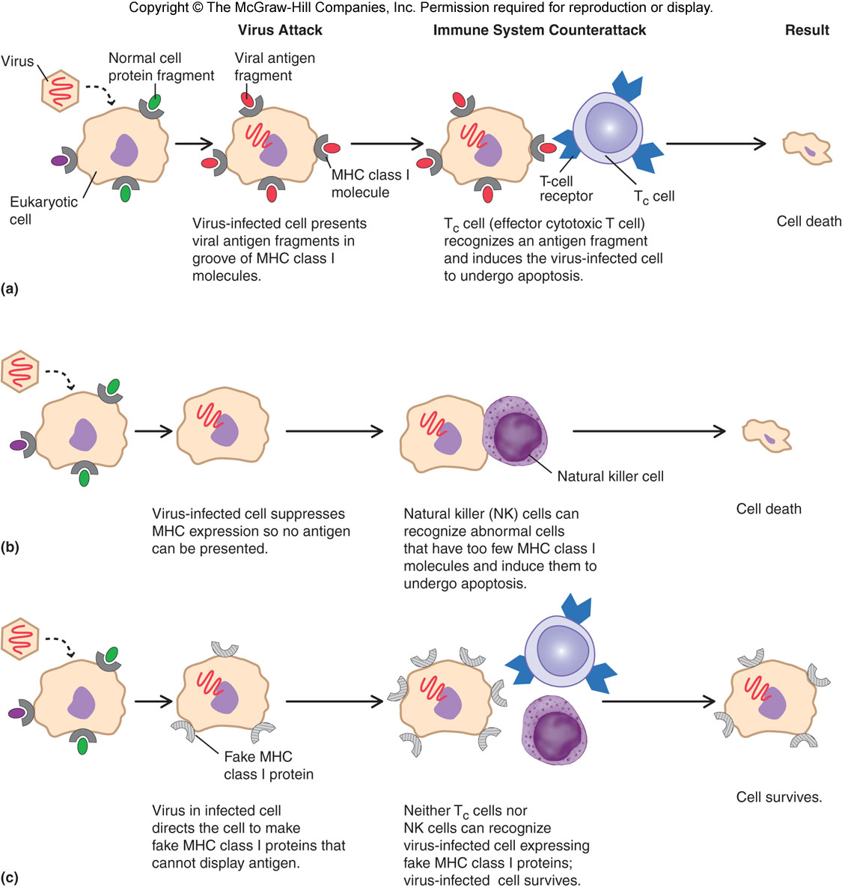
Mechanisms of Viral Pathogenesis

